Slide 1
Online Voting System
UNDER THE GUIDANCE OF :
POOJA MEHTA
SUBMITTED BY:
Tauhid Bashir Karol
Sufiyan Surve
Prathampal Singh Bhamrah

Slide 2
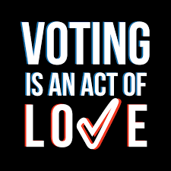
INTRODUCTION
An online voting system is an electronic platform that allows eligible voters to cast their votes via the internet, offering an alternative to traditional paper-based voting methods. It aims to improve accessibility, convenience, and efficiency in the electoral process.
Key benefits of online voting include increased accessibility, as voters can participate from anywhere with an internet connection, reducing the need for physical polling stations and making it easier for people in remote areas or with disabilities to vote. It also offers convenience, allowing voters to cast their ballots at any time within a designated window, potentially increasing voter turnout.
The system can be more cost-effective by reducing expenses related to paper ballots, polling station setup, and election staff. Additionally, the counting process is faster, leading to quicker election results

Slide 3
PROJECT OBJECTIVE
The objectives of an online voting system project are focused on ensuring security, accessibility, and transparency while maintaining legal and technical integrity. Key project objectives include:
User Accessibility: A user-friendly interface is crucial for ensuring that all eligible voters, including those with limited technical knowledge, can easily participate. The system should be accessible across various devices (e.g., desktops, smartphones) and comply with accessibility standards for people with disabilities.
Scalability and Reliability: The system must be scalable to handle high voter traffic, especially on election day, without performance degradation.
User Accessibility: A user-friendly interface is crucial for ensuring that all eligible voters, including those with limited technical knowledge, can easily participate.

Slide 4
TECHNOLOGY USED
SPRING
JAVA
Spring Boot is an advanced application framework, designed to simplify the development of Java applications by providing built-in tools and libraries
Java is an object-oriented programming (OOP) language, which means it supports the principles and concepts of object-oriented programming.
Java
Spring
HTML
angular
HTML, which stands for Hypertext Markup Language, is the standard markup language used for creating and structuring web pages.
ANGULAR
Angular is a TypeScript-based framework that uses HTML, CSS, and JavaScript to build robust and scalable single-page applications.
Postman
POSTMAN
JAVASCRIPT
Postman is a popular collaboration platform and toolset used by developers to build, test, and document APIs
JavaScript is a widely used programming language primarily used for web development.

Slide 5
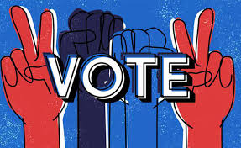
PROPOSED SYSTEM
The platform for voters to browse proposed system of an online voting system aims to provide a seamless and user-friendly, select, and contribute their precious votes from the comfort of their homes.
Given comprehensive full-stack project combines the power of Java Spring Boot, Hibernate, MySQL, and Angular.
This system aims to address the challenges of modern web development by utilizing Java Spring Boot for rapid backend development, Hibernate for seamless communication with the MySQL database, and Angular for creating dynamic and interactive user interfaces. By leveraging these technologies, we can deliver a robust, scalable, and user-friendly application that meets the demands of today's web development landscape.

Slide 6
REQUIRED SPECIFICATIONS
HARDWARE CONFIGURATION | SOFTWARE CONFIGURATION
Operating System : Windows 10 and above | Software IDE: Eclipse, Postman, MySQL, VS Code.
Hard Disk: 500 GB | Language: JAVA, Type Script, HTML, CSS
RAM: 6 GB | Front End: Angular, Boot Strap Back End: Spring Boot, MySQL.

Slide 7
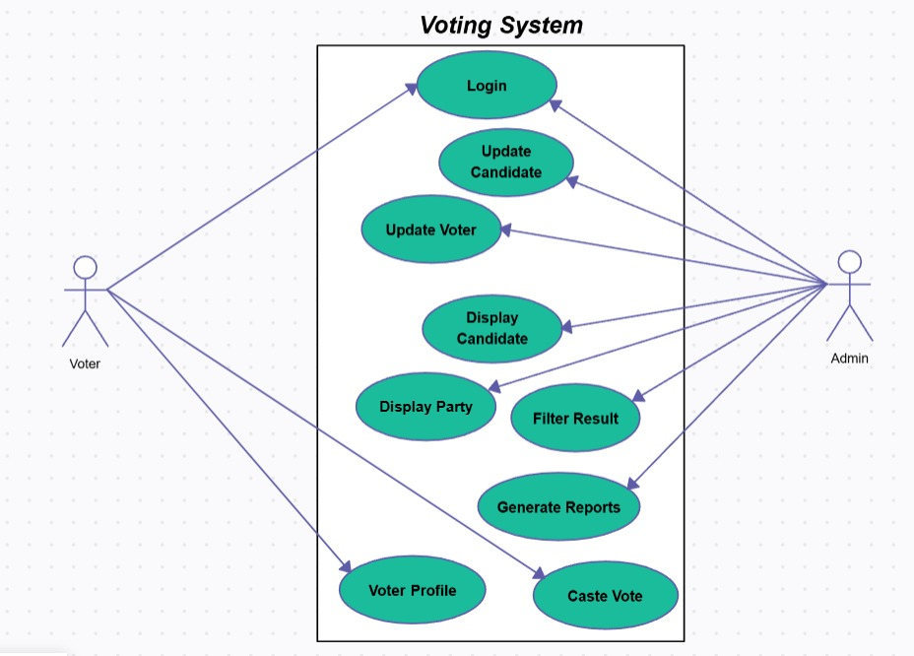
CONNECTION TO DATABASE

Slide 8
MODULES
01
ADMIN :-
Register and Login.
02
VOTER :-
Register and Login.
03
VOTER LIST :-
Username User Gender User Date Of Birth User Email User Address User Mobile No User Voting No User Account Status User Action
04
LIST PARTY:-
Party Logo, Party Name, Party Candidate, Constituency, Candidate Image etc. after selecting candidate.
05
RESULT :-
Admin can view the result and declare the wining party.

Slide 9
SPRING NOTATATIONS
@Controller : | The @Controller annotation indicates that a particular class serves the role of a controller. Spring Controller annotation is typically used in combination with annotated handler methods based on the @RequestMapping annotation.
@Autowired | The @Autowired annotation provides more fine-grained control over where and how auto-wiring should be accomplished. Auto wiring feature of spring framework enables you to inject the object dependency implicitly. It internally uses setter or constructor injection.
@RequestMapping | The @RequestMapping is one of the most common annotation used in Spring Web applications. This annotation maps HTTP requests to handler methods of MVC and REST controllers.
@Entity | The @Entity annotation specifies that the class is an entity and is mapped to a database table.
@Table | The @Table annotation is used to create a table in database.
@JoinColumn | The @JoinColumn is used to specify a column for joining an entity association or element collection.

Slide 10
SPRING NOTATATIONS
@PutMapping | The @PutMapping is used for update the records.
@PostMapping | The @PostMapping is used to create a resource Mapping.
@GetMapping | The @GetMapping is used to read all the inserted records.
@DeleteMapping | The @DeleteMapping is used to delete the records.
@PathVariable | The @Path Variable annotation is used to extract the value from the URL.
@RequestParam | The @RequestParam annotation is used to read the form data and bind it automatically to the parameter present in the provided method.

Slide 11
SPRING NOTATATIONS
@Request Body | The @RequestBody annotation is applicable to handler methods of spring controller. spring should deserialize a request body into an object.
@OneToOne Mapping | The @OneToOne JPA annotation is used to map the source entity with the target entity, Hibernate maps the tables in your database to the Entity classes in your application.
@OneToMany Mapping | The @OneTo-Many relationship between table A and table B indicates that one row in a table A link to many rows in table B but one row in table B links to only one row in table A.
@ManyToOne Mapping | The @Many-to-One mapping means that many instances of this entity are mapped to one instance of another entity.
@ExceptionHandler | The @ExceptionHandler is an annotation used to handle the specific exceptions and sending the custom responses to the client.
@ControllerAdvice | A controller advice allows you to use exactly the same exception handling techniques but apply them across the whole application, not just to an individual controller. You can think of them as an annotation driven interceptor.

Slide 12
ADVANTAGES
An online voting system offers several advantages, particularly in terms of convenience, accessibility, and efficiency. Below are the key benefits:
1. Convenience
Accessibility from Anywhere: Voters can cast their votes from any location with internet access, which is particularly useful for those living in remote or distant areas.
Time Flexibility: Online voting systems can be available 24/7 during election periods, allowing voters to participate at their convenience rather than being restricted to specific polling hours.
2. Cost-Effective
Reduced Operational Costs: Traditional voting systems often involve significant costs, such as printing ballots, renting polling stations, paying staff, and transporting election materials. Online voting reduces or eliminates many of these expenses.
Lower Infrastructure Costs: There's no need for physical voting booths, ballot papers, or materials, resulting in savings for governments or organizations organizing elections.

Slide 13
Advantages
3. Accessibility for People with Disabilities
Support for Various Needs: Online voting platforms can be designed with accessibility features such as screen readers, magnification, and alternative input devices, ensuring that people with disabilities can participate more easily.
4. Environmental Benefits
Paperless Voting: Online voting eliminates the need for physical ballots, reducing paper waste and the environmental impact associated with printing, transportation, and storage of paper ballots.
5. Faster Results
Instant Tallying: Once the election period ends, the votes are automatically tallied, allowing results to be known immediately rather than requiring manual counting and verification.
Quick Reporting and Transparency: The system can instantly provide breakdowns of voting results, reducing the time taken to announce the outcome.

Slide 14
DISADVANTAGES
While online voting systems offer numerous advantages, they also present several challenges and potential risks. Here are some of the key disadvantages of online voting systems:
1. Security Concerns
Vulnerability to Cyberattacks: Online voting systems are susceptible to hacking, phishing, and other cyber threats. Cybercriminals could exploit vulnerabilities to manipulate votes, alter results, or disrupt the election process.
Data Breaches: Personal and voting data stored in online systems could be exposed in a data breach, leading to potential privacy violations and undermining trust in the system.
2. Lack of Digital Literacy
Not Accessible to All Voters: Some segments of the population, particularly the elderly, those with limited education, or people who are unfamiliar with digital technologies, may struggle to use online voting platforms. This could lead to disenfranchisement or incorrect voting.
Digital Divide: Voters without access to reliable internet, computers, or smartphones—especially in rural or economically disadvantaged areas—could be excluded from the voting process.

Slide 15
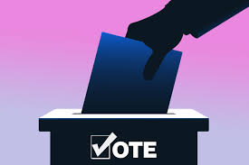
CONCLUSION
The online voting system presents a promising advancement in how elections can be conducted, offering significant advantages such as increased accessibility, convenience, and efficiency. It can simplify the voting process, improve voter turnout, and reduce costs associated with traditional voting methods. The ability for voters to participate from anywhere, at any time, is particularly beneficial in an increasingly digital world where people are seeking more flexibility and inclusivity in democratic processes.
However, the implementation of online voting is not without its challenges. Security concerns, digital literacy gaps, privacy issues, and the risk of voter coercion must be carefully addressed to ensure the integrity of elections. The potential for cyberattacks, data breaches, and technical failures raises serious concerns about the reliability of online voting systems. Furthermore, ensuring equal access for all voters, particularly those without digital resources or expertise, is critical to prevent disenfranchisement.

Slide 16
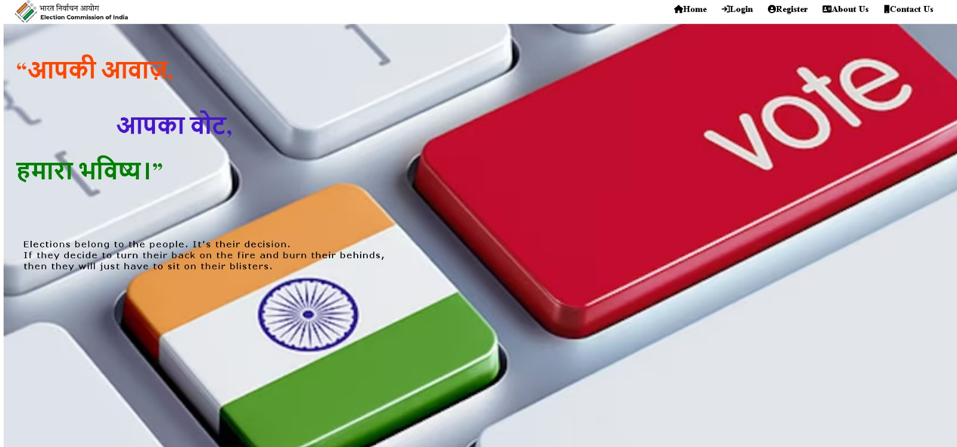
Home Page

Slide 17
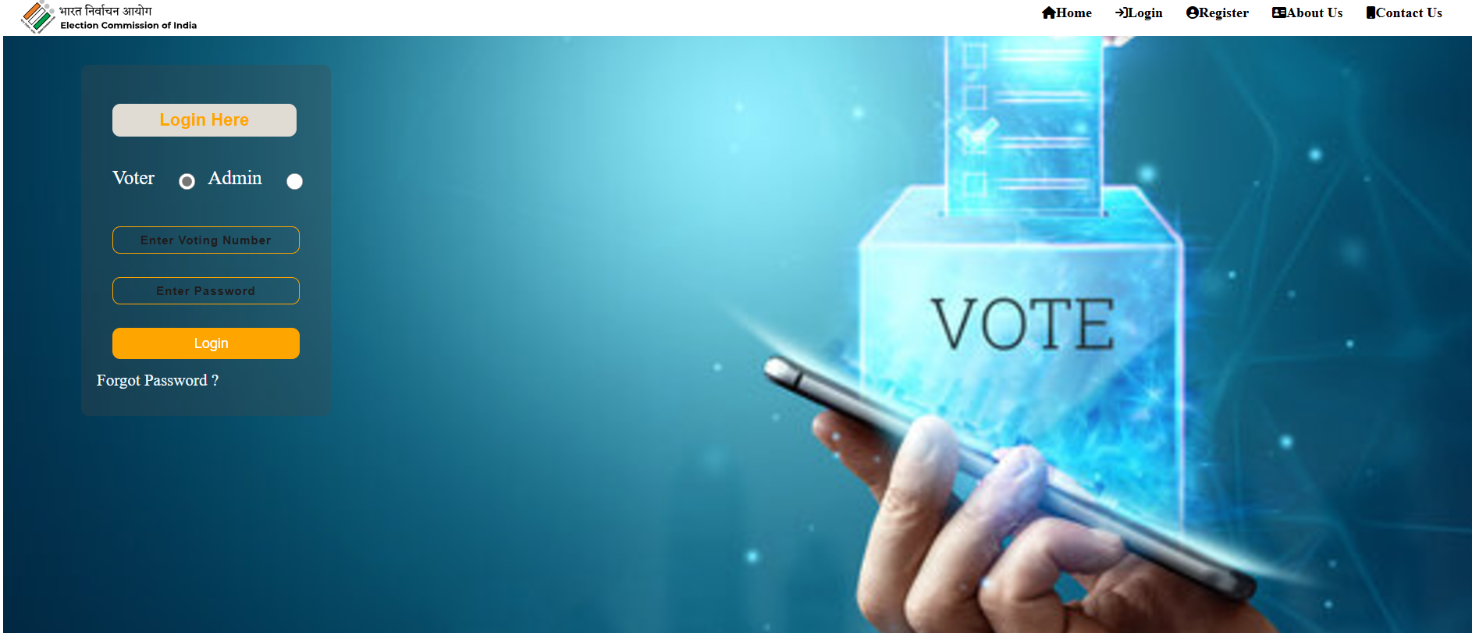
Login PAge

Slide 18
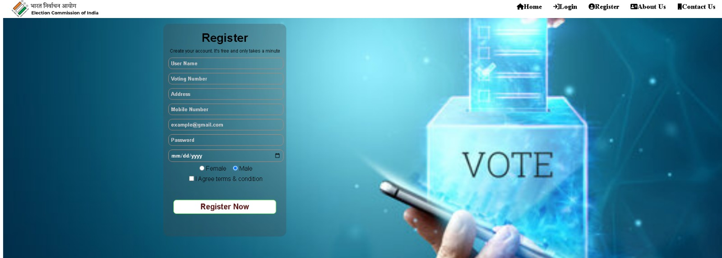
Registration Page

Slide 19
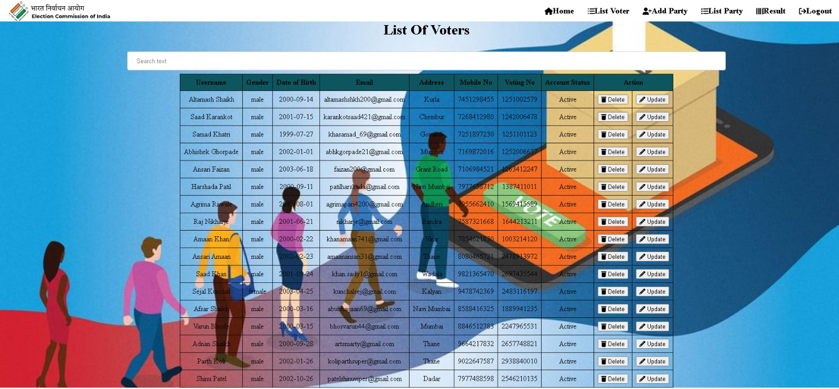
List Voters

Slide 20
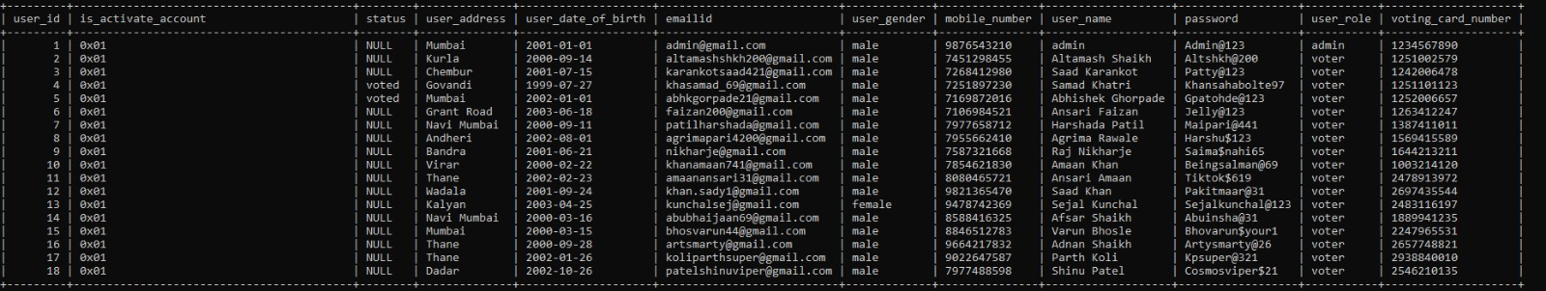
List VOTERS DATABASE

Slide 21
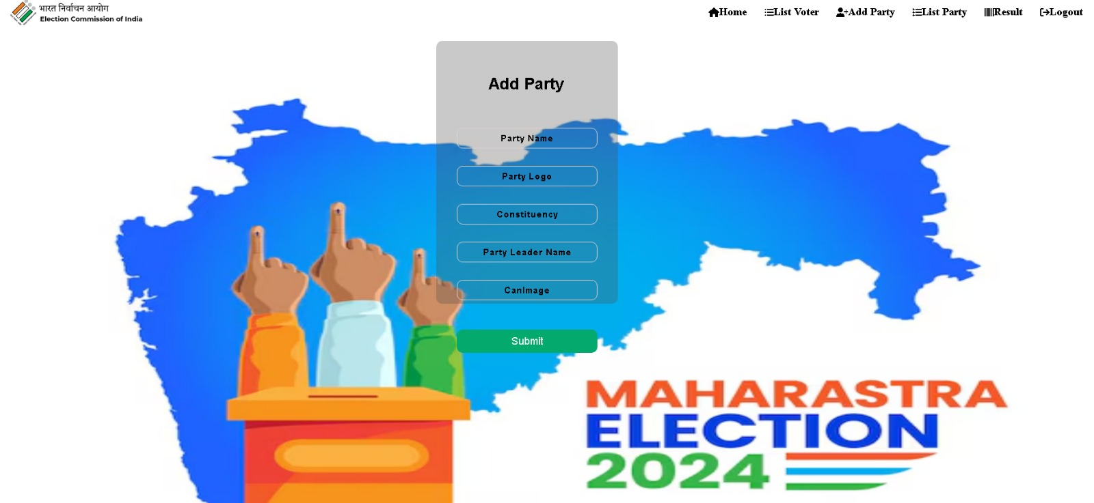
Add party

Slide 22
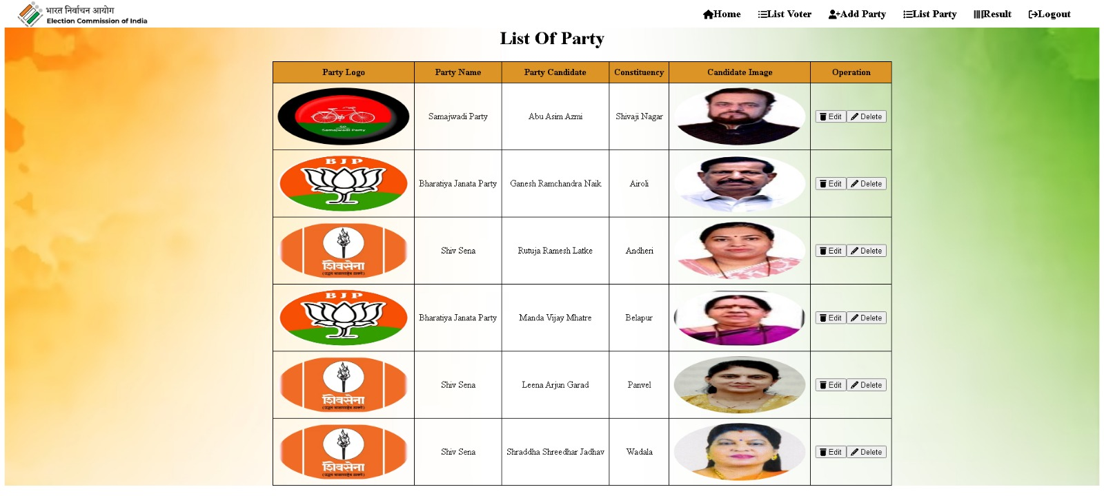
List Party

Slide 23
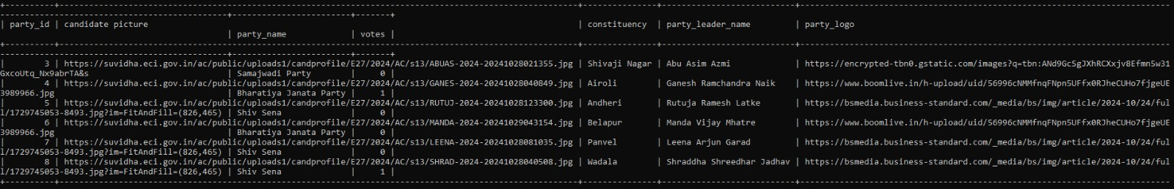
LIST PARTY DATABASE

Slide 24
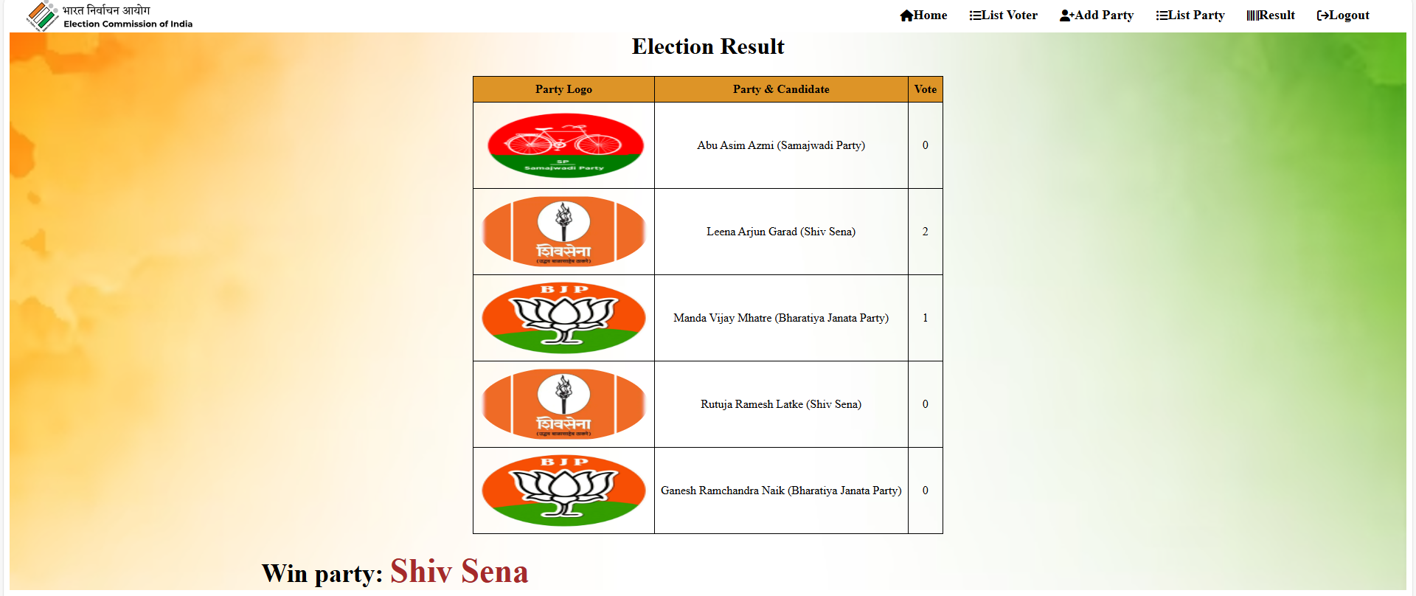
Result

Slide 25
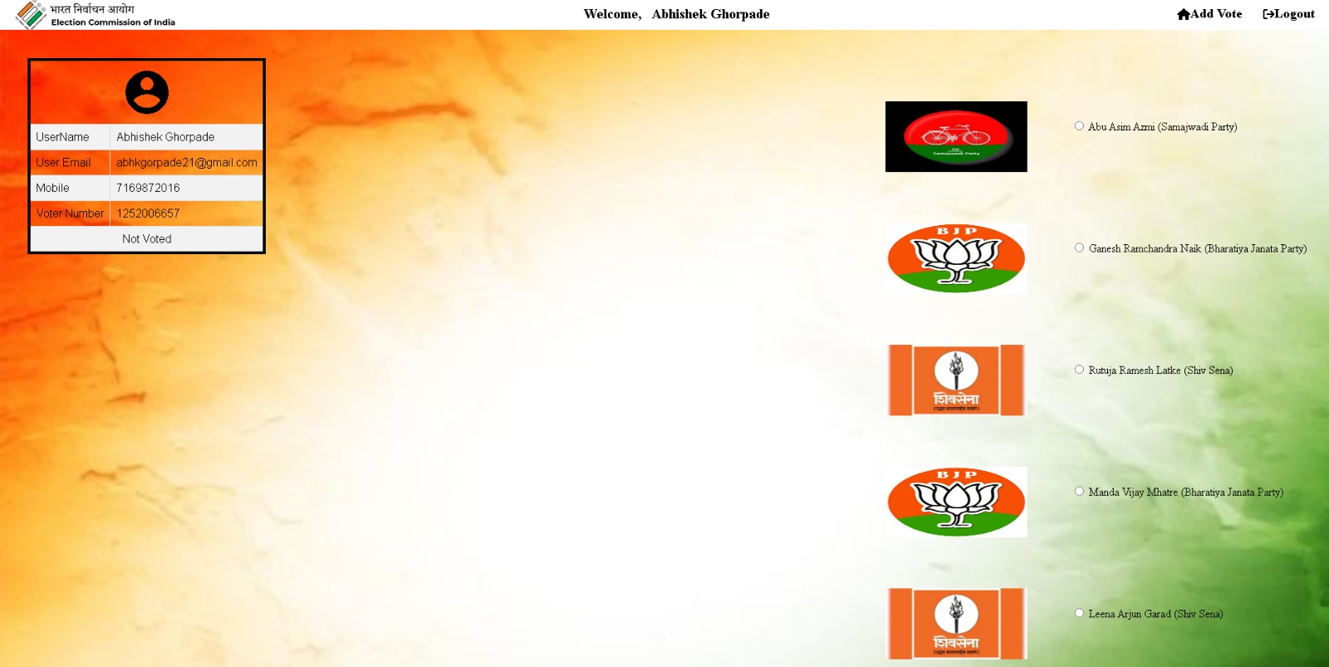
Voter dashboard

Slide 26
